Slide 1
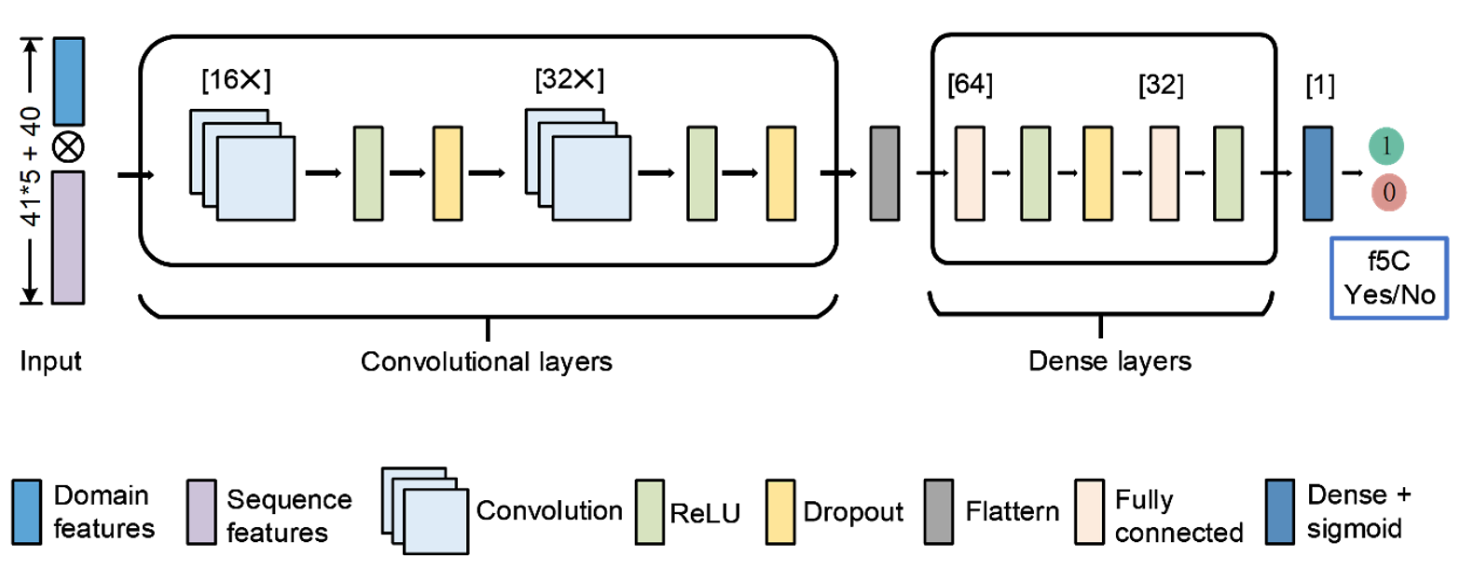
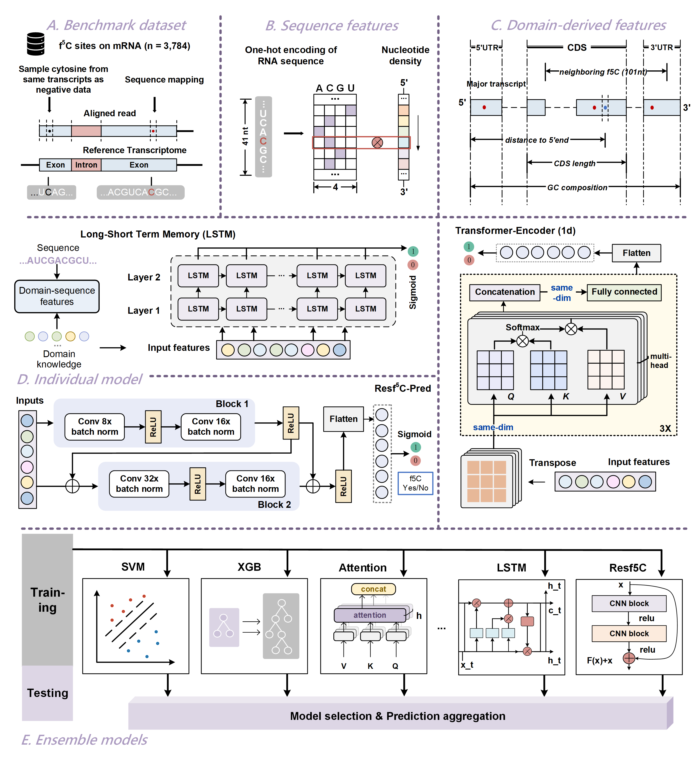

Slide 2






Long-Short Term Memory (LSTM)
A. Individual Models
Residual Neural Network (ResNet)
CHD
Yes/No
ResNet
B. Ensemble Models

Slide 3
(A) 4 ML Approaches
(a1) LR
(a2) NB
(a3) RF
(a4) SVM
(B) 2 DL Approaches
(b1) LSTM
(b2) ResNet

